Slide 1
Raspberry Pi - Notes
www.codehafeez.com

Slide 2
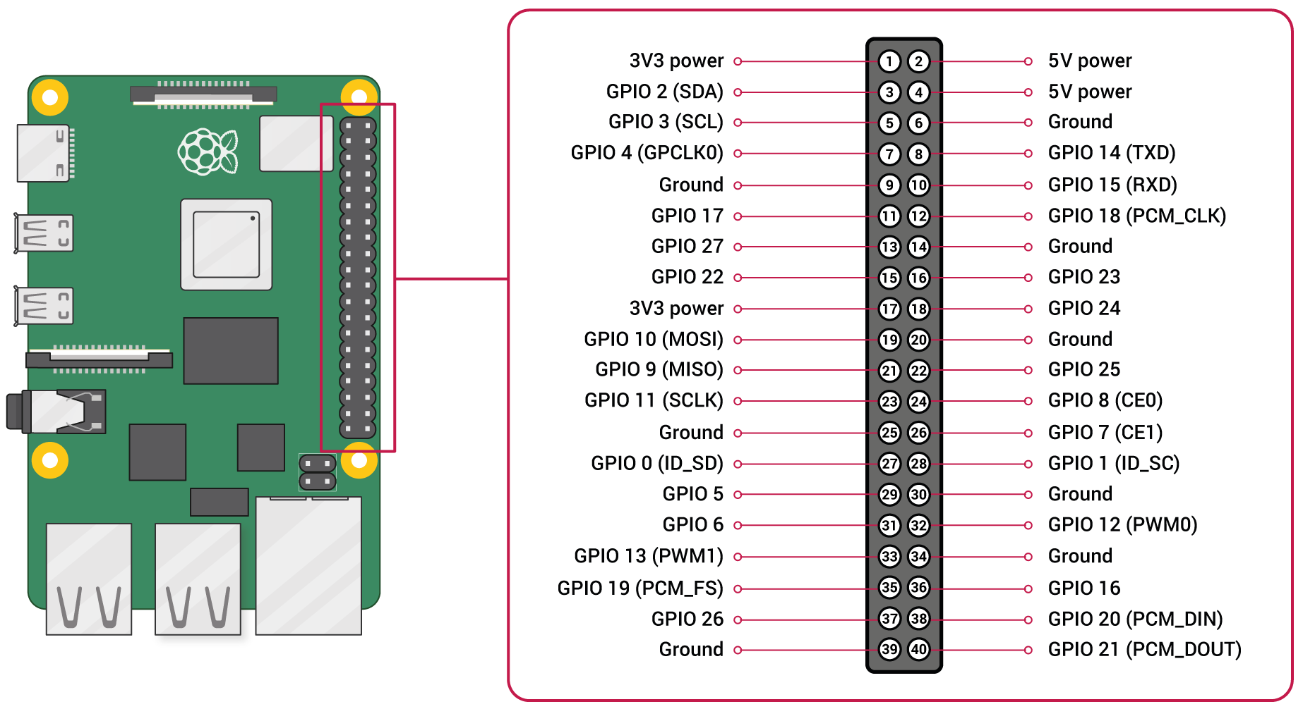
Raspberry Pi GPIO Pins

Slide 3
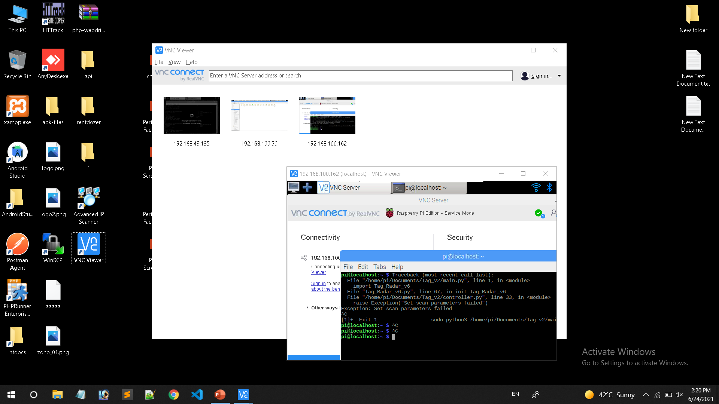
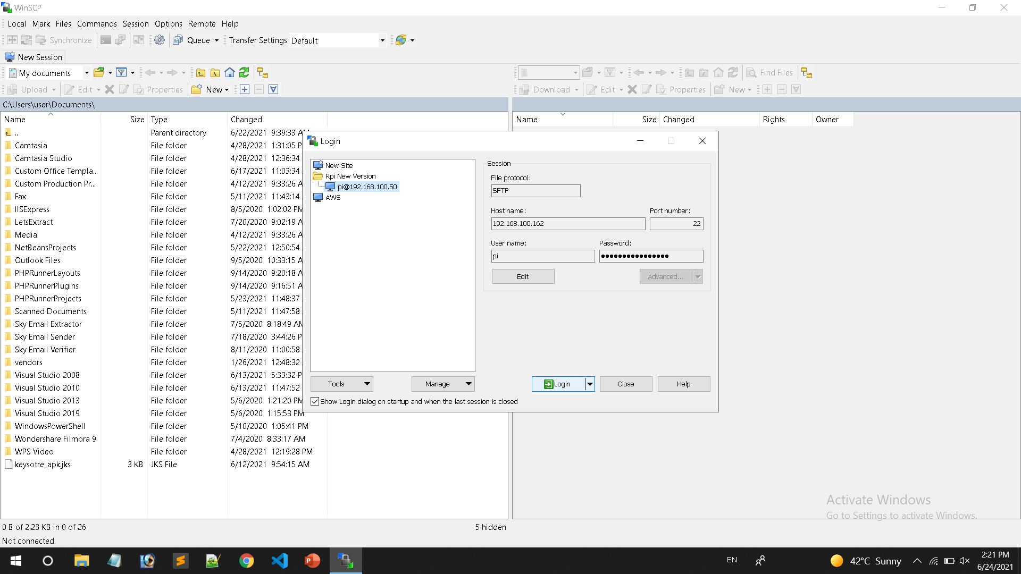
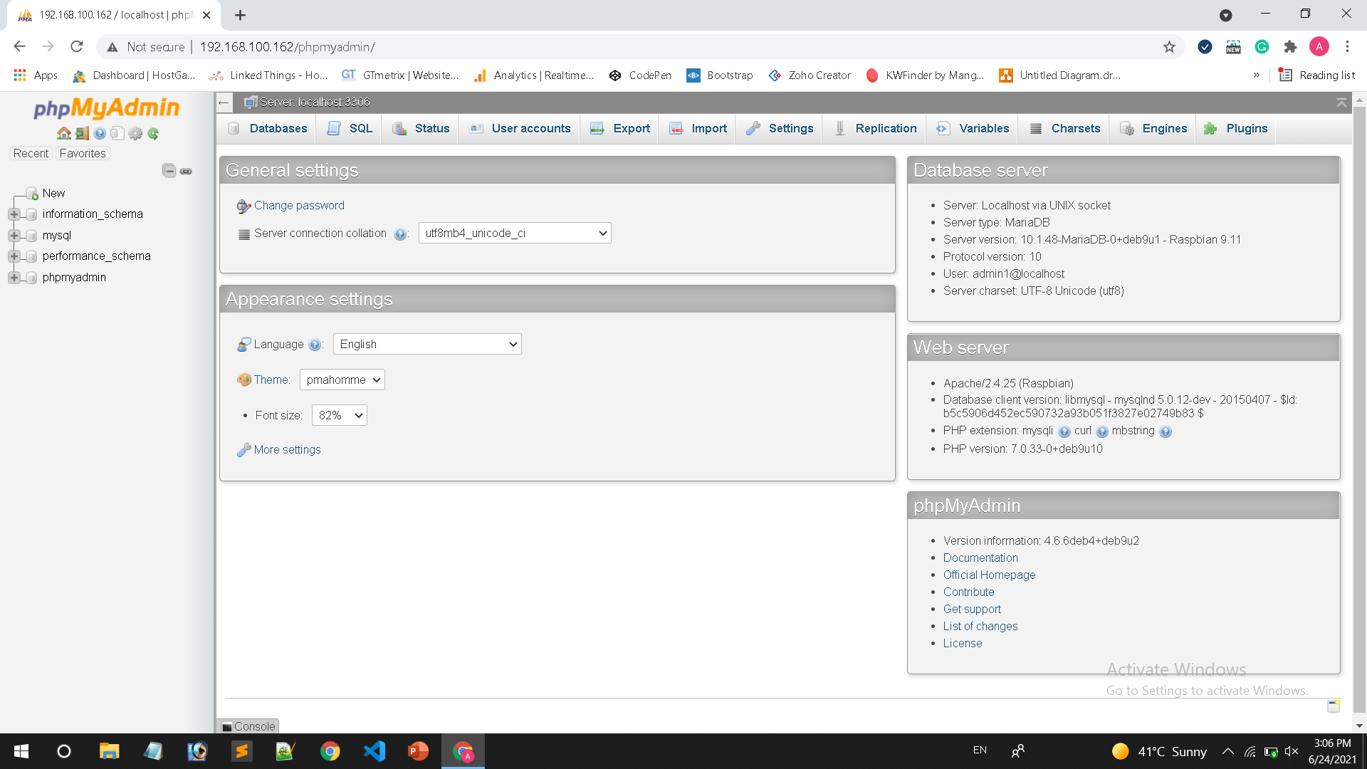
XAMP install on R-PI
CTRL + ALT + T => Open CMD
Follow the steps:
https://randomnerdtutorials.com/raspberry-pi-apache-mysql-php-lamp-server/

Slide 4
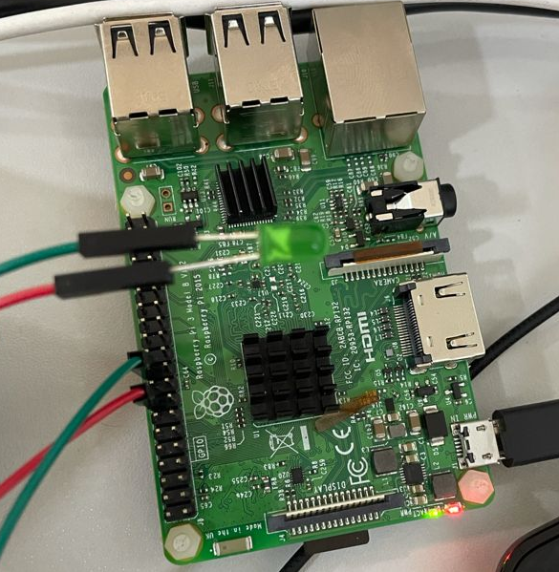
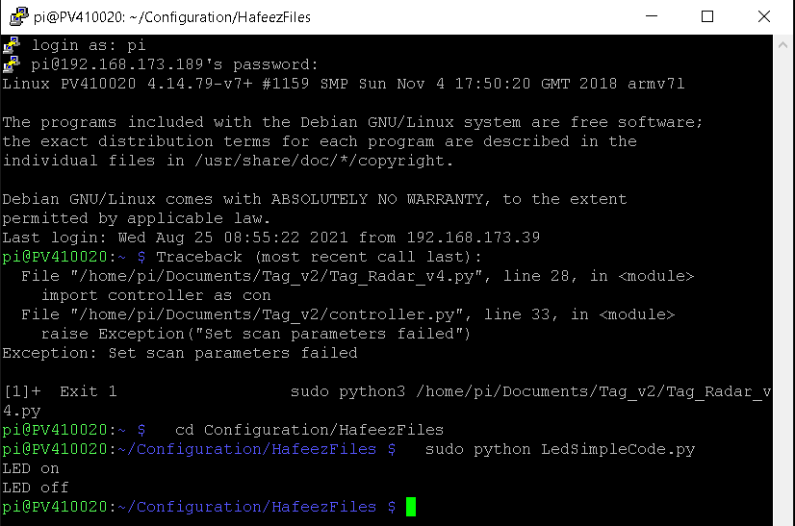
LED On / Off Simple Code
import RPi.GPIO as GPIO
import time
GPIO.setmode(GPIO.BCM)
GPIO.setwarnings(False)
GPIO.setup(23,GPIO.OUT)
print "LED on"
GPIO.output(23,GPIO.HIGH)
time.sleep(1)
print "LED off"
GPIO.output(23,GPIO.LOW)
cd Configuration/HafeezFiles
sudo python Led-On-Off.py

Slide 5
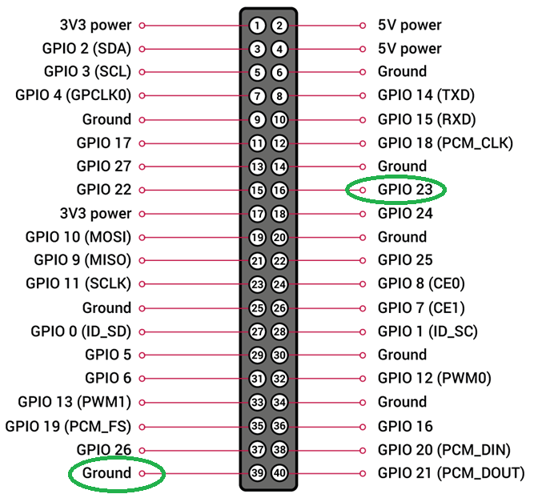
LED On / Off Simple Code
import RPi.GPIO as GPIO
GPIO.setmode(GPIO.BCM)
GPIO.setwarnings(False)
GPIO.setup(23,GPIO.OUT)
print "LED on"
GPIO.output(23,GPIO.HIGH)
import RPi.GPIO as GPIO
GPIO.setmode(GPIO.BCM)
GPIO.setwarnings(False)
GPIO.setup(23,GPIO.OUT)
print "LED off"
GPIO.output(23,GPIO.LOW)

Slide 6
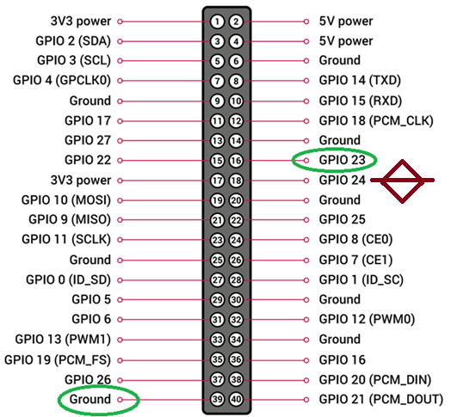
import RPi.GPIO as GPIO
import time
GPIO.setmode(GPIO.BCM)
GPIO.setup(24, GPIO.IN, pull_up_down=GPIO.PUD_UP)
GPIO.setup(23, GPIO.OUT)
try:
while True:
button_state = GPIO.input(24)
if button_state == False:
GPIO.output(23, True)
print('Button Pressed...')
time.sleep(0.2)
else:
GPIO.output(23, False)
except:
GPIO.cleanup()

Slide 7
from signal import pause
from time import sleep
from gpiozero import LED, Button
blink_on = False
interval = 0.5
button = Button(21)
led1 = LED(26)
led2 = LED(19)
def go_blink():
global blink_on
if blink_on:
led1.off()
led2.off()
else:
led1.blink(interval, interval)
sleep(interval)
led2.blink(interval, interval)
blink_on = not blink_on
try:
button.when_pressed = go_blink
pause()
except KeyboardInterrupt:
pass
finally:
led1.close()
led2.close()
// WORKING CODE
from signal import pause
from time import sleep
from gpiozero import LED, Button
blink_on = False
interval = 0.5
button = Button(24)
led1 = LED(23)
def go_blink():
global blink_on
if blink_on:
led1.off()
print('off')
else:
print('on')
led1.blink(interval, interval)
sleep(interval)
blink_on = not blink_on
try:
button.when_pressed = go_blink
pause()
finally:
led1.close()

Slide 8
